Slide 1

Introduction
Azure SQL DB Service
2019.12.15
Bak Chan

Slide 2
Contents
Introduction
What is Azure SQL DB Service
Create SQL in AZ VM
Azure SQL
Question

Slide 3

What is Azure SQL DB Service
Azure SQL (DBaaS)
PaaS Service
User DB only
99.995% Availability

Slide 4
What is Azure SQL DB Service
SQL in Azure VM
IaaS Service
Avaiability 99.99 %

Slide 5
Sequence
SQL Server 2017 Enterprise
Window Server 2016
SQL Server Connect
SQL Query
1
3
5
SQL Install
Setting
Conect
Create DB
SQL Query
2
4
IP-Configuration Setting
Create SQL DB

Slide 6
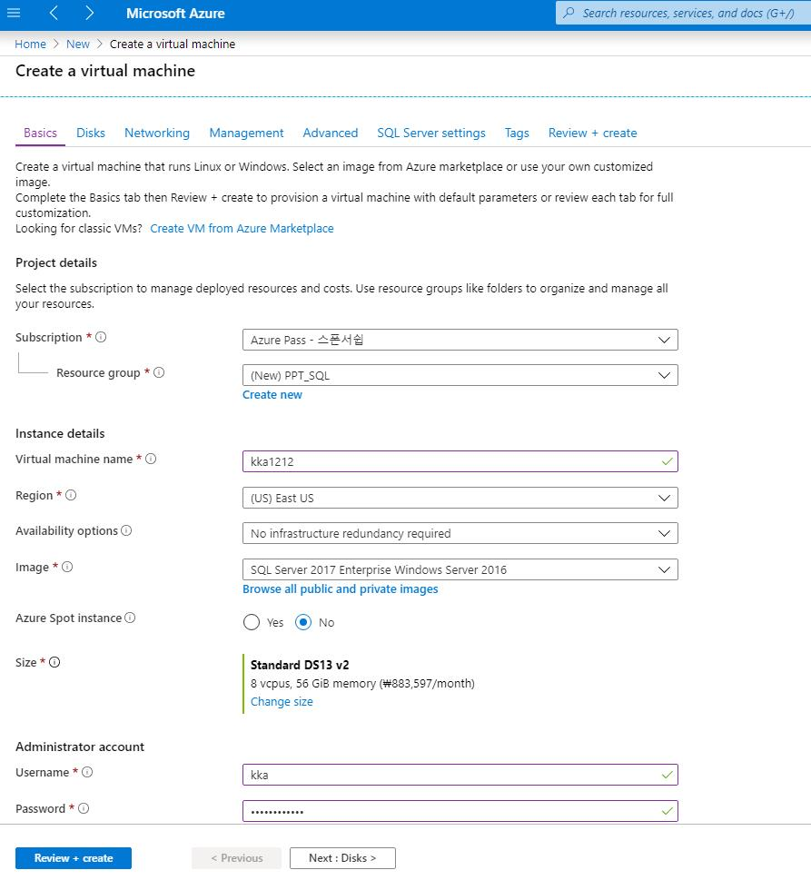
Create SQL in Azure VM
1
Create SQL in Azure VM

Slide 7
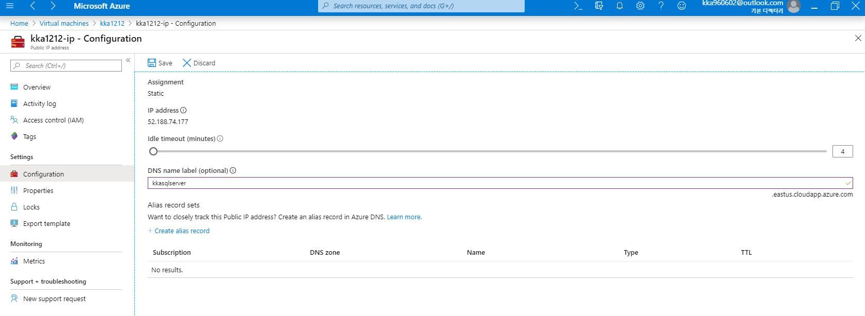
Create SQL in Azure VM
2
IP-Configuration Setting

Slide 8
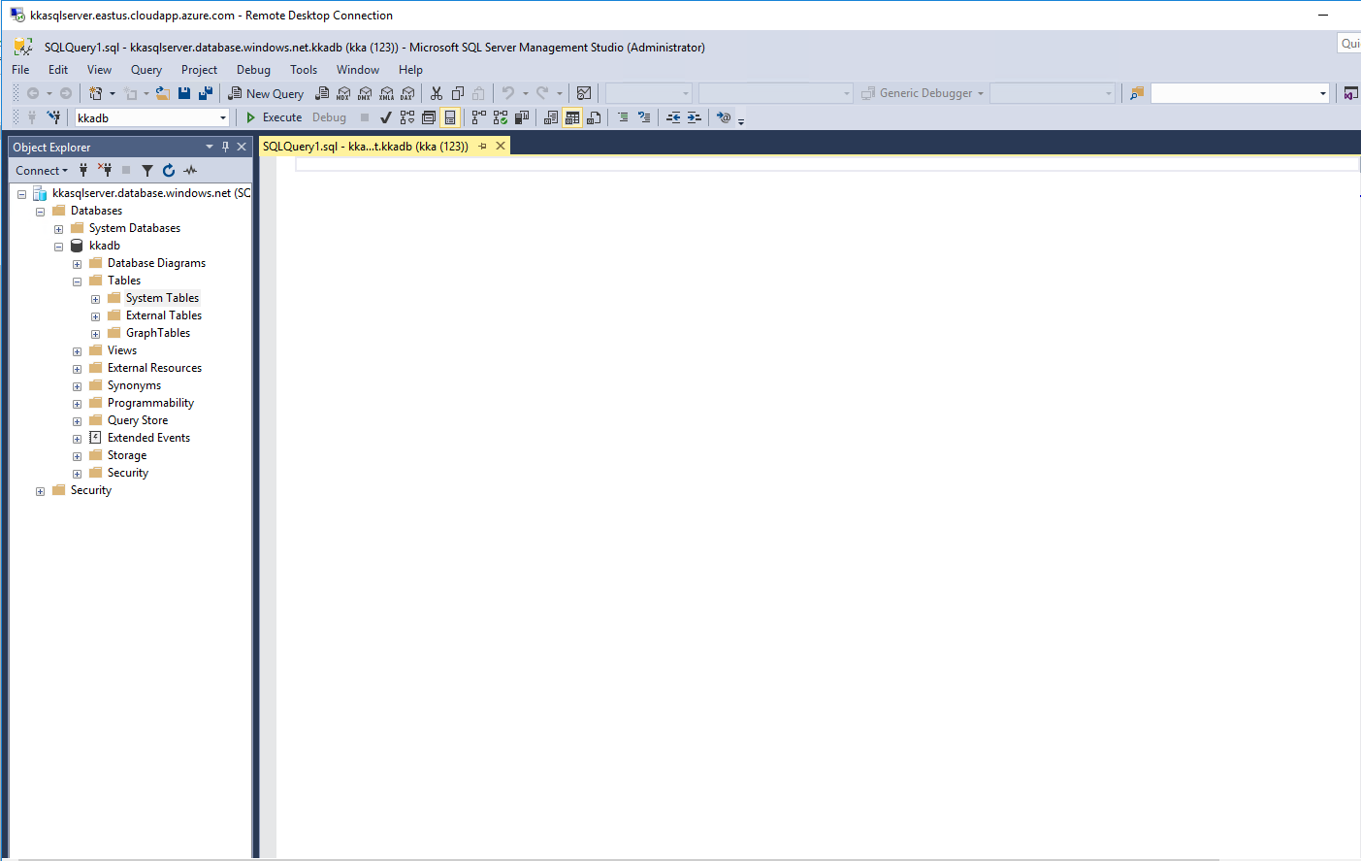
Create SQL in Azure VM
3
SQL Server VM Connection

Slide 9
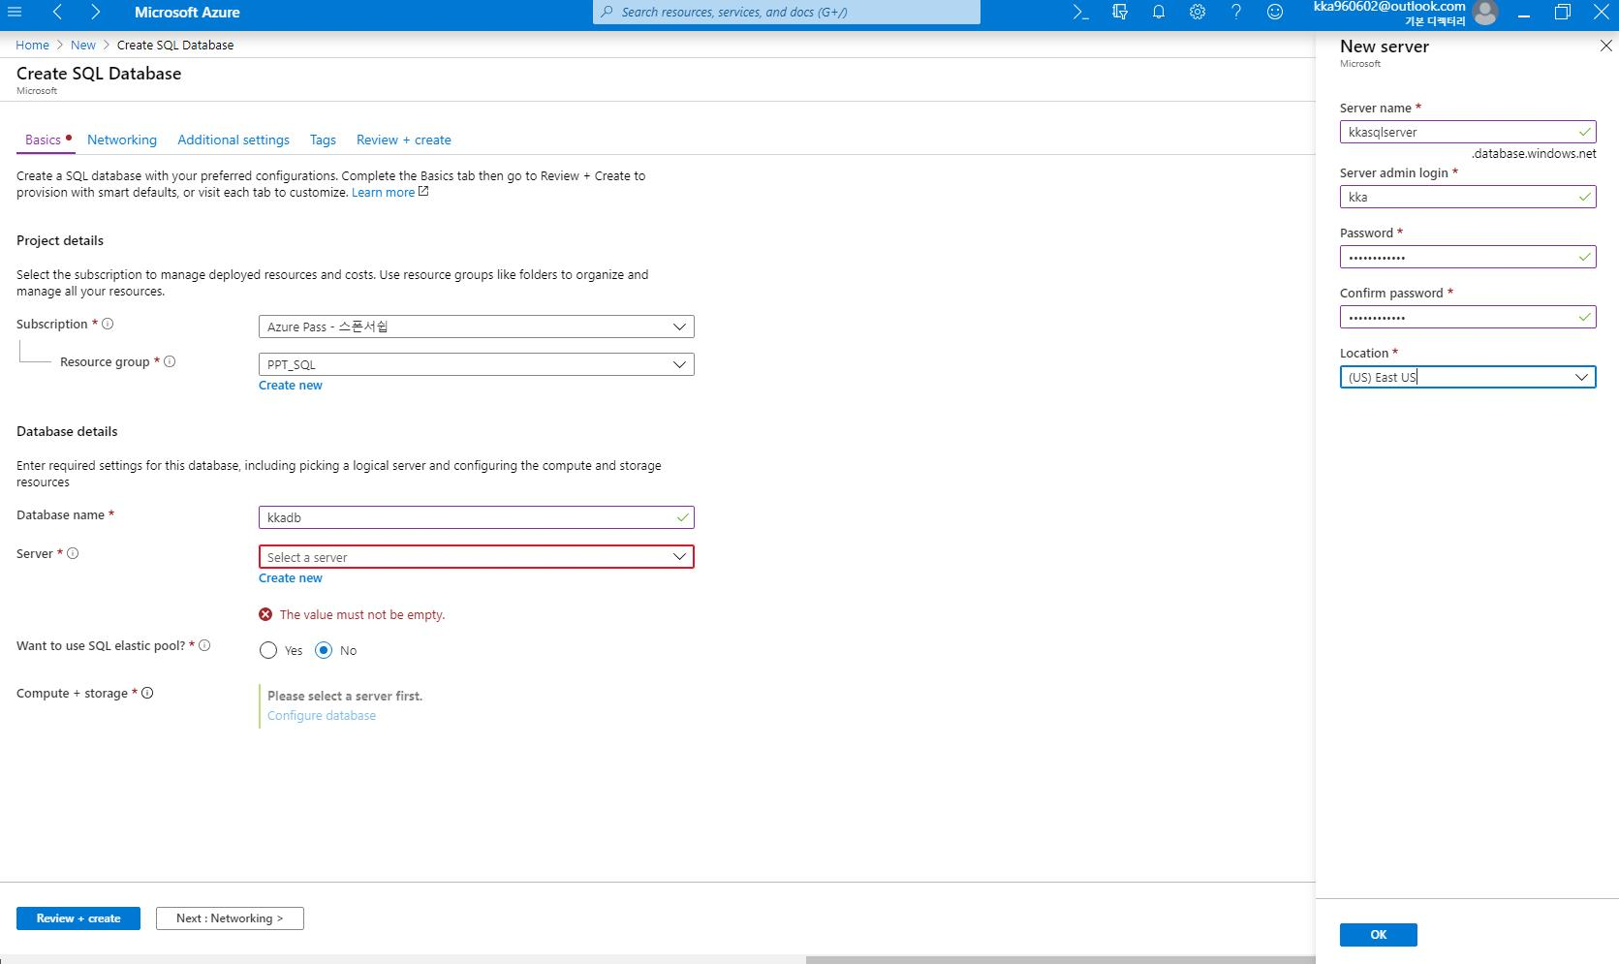
Create SQL Database
1
SQL Database

Slide 10
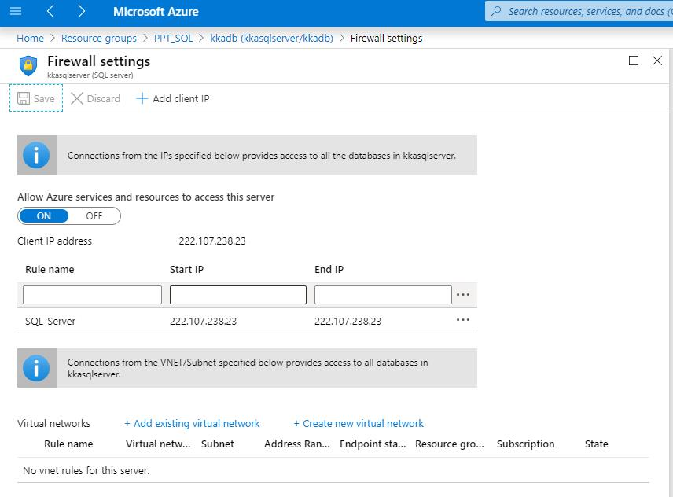
Create SQL Database
2
Firewall Setting

Slide 11
Create SQL Database
3
SQL Server 접속

Slide 12
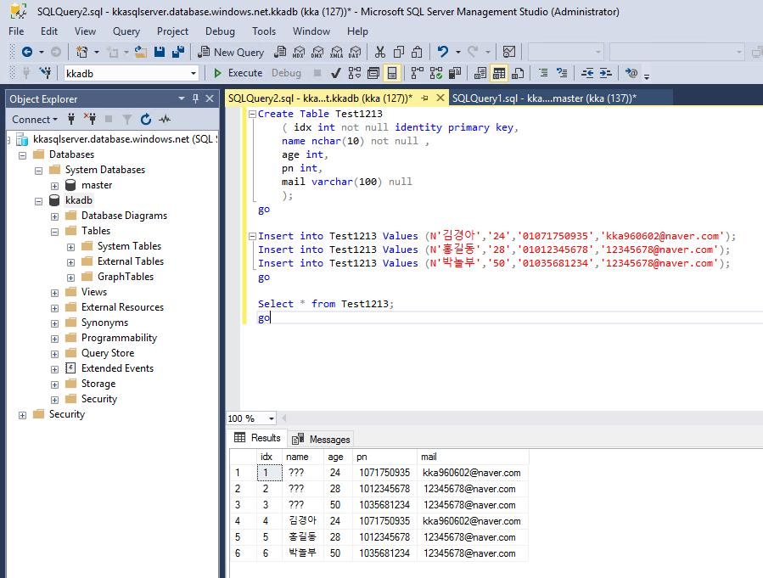
Create SQL Database
4
SQL Data Definition Language Query

Slide 13


